Slide 1
CRYO Naming Conventions (MINERVA/Cryogenics)
Daniel Berkowitz (MDB/ADB)
19-JAN-2022

Slide 2
CRYO Architecture
Based on:
“Cryogenic System - Architecture for MINERVA” (ALX-40629944)

Slide 3
MINERVA’s Cryo-architecture
QSYS
(from ALX-40629944)
MINERVA Cryogenic System
Naming Convention (SCK-CEN/42055443)
Cryogenic Supply System (CSS)
Infrastructure
Cryoplant
Cryogenic Distribution System
Storages
Warm compressor stations
Refrigerator cold-box
Cryogenic transfer lines
Cryogenic Cell
Refrigerator cold boxes
Warm compressor station
Gas management
He purification system
He recovery system
Warm Piping System
Cryogenic distribution boxes
Main Cryogenic Line (QRB ↔ QVB)
Cryomodule’s valve-box
HP gaseous warm He storage (GHe)
Liquid He storage (LHe)
Liquid N2 storage (LN2)
General piping
Cryomodules
End-box
Cryogenic Users
QINFRA
QPLANT
QDIST
QCELL
_S_
_G_
_P _
_C_
_R_
_L_
_V_
WSH
WGP
WPS
WCS
QRB
QLM
QVB
QM
QSH
WGR
Supply lines (U)
Recovery lines (W)
SV lines (S)
Vent lines (V)
Compressor skids (SP, LP, and MP)
Gas regulation panel
Oil removal system
Dryers (if not part of purification system)
Cold Compressors
Main process section (HX, turbines, etc)
Warm-section panel
QVE
LINAC Configuration:
24 QMs: initial / current implementation.
30 QMs: design point for CRYOSYS.
[Not Baseline]
Cryogenic Distribution Backbone (QDB)
WGR-PS: for LINAC (ACC PS)
WGR-MAC: for MAC
[Not Baseline]
QSN
To assist pre-cooling and/or purification units
- Incl. transfer lines
For aiding the main process (buffering)
- Incl. transfer lines
Utilities ACC
Electrical power
Compressed air
Cooling water
HVAC
Supporting Systems
Insulation Vacuum
Controls for QCELL & QDIST
Controls for QPLANT
NA.ESxx
NA.PS01
NA.PS05
NA.HV03
ACC PS/INVAC
CIS/xxx Column
CIS/Cryo Column

Slide 4
Primary Systems
Accelerator (ACC) side.
Based on:
“Primary system naming convention” (ALX/37442504)

Slide 5


Primary-system mnemonics (1)
ACC naming convention
X – X : X – X – ##
Full Mnemonics of the cryomodule at this particular section/sub-section:
LB-S03:CRYO-QM-01
Suffix (01-99)
Device Class (i.e. QM)
Discipline (i.e. CRYO)
The suffix “01” indicates that this is the 1st QM in the sub-section “LB-S03”. Sidenote: the LINAC has exactly one QM per section)
Sub-section (i.e. S03)
All cryomodules containing “low-beta single-spoke cavities” are of class/sub-class:
QM-LB
Section (i.e. LB)
Different types of the same device class are distinguished by their “sub-class”
X – X
Device Sub-class (i.e. LB)
Device Class (i.e. QM)
Cryo-Cell
(QCELL)
Valve box (QVB)
Storage
(NA.CP03.xSx)
Cryoplant (NA.CP01)
Cryo-distribution line (NA.CP02.QLR+QLM)
(Only Helium is used as the cooling fluid)
Cryomodule (QM)
→ each QM contains 2 cavities (CAV)
QLR
Sub-section of the low-beta LINAC (“LB-Sxx”)
Based on ACC Layout SCK/37633125 v3.0
Entrance LINAC tunnel
End-Box (NA.CP02.QVE)
QLM
Injector
LB-S30
LB-S01
0+24 QMs (current implementation)
Beam direction
To the target facilities
0+30 QMs (Full MINERVA LINAC)

Slide 6
Primary-system mnemonics (2)
For a complete list see ALX/37442504
Mnemonics for sections and subsections (primary system) relevant for the cryogenic system.
Section | Subsection | Start || End of the subsection | Description / comment
LB |  |  | low beta linac
 | ME3 | injector selection magnet (including) || entrance of the first cryo module doublet | low beta part of the MEBT3
 | S01 | start of the first cryomodule doublet || start of the second cryomodule
 | S02 | start of the second cryomodule doublet || start of the third cryomodule
 | ….
 | S30 | start of the 30th cryomodule doublet || end of the 30th cryomodule
Mnemonics for disciplines and classes (primary system) relevant for the cryogenic system.
Discipline | Device (class-subclass) | Description | NOTES
CRYO |  | cryogenics
 | (Qxxx) | (general rule for cryogenic devices) | Example of mnemonics for a generic cryogenic device
 | (QxxxST) | (general rule for cryostat of a "Qxxx" device) | Example of mnemonics for a generic cryostat. Cryostats in general = Vacuum vessel, thermal shield, mechanical support, cryo-tank&piping, MLI, instrumentation.
 | QCELL-LB | cryogenic cell = QVB + QM as single unit | = cryogenic valve box (QVB) + cryomodule (QM)
 | QM-LB | cryomodule = QMST + CAV assy | CAV assy = CAV, CPLR, CTS, warm valves, mag. shield, and flanges.
 | QMST-LB | QM cryostat | = Vac vessel, thermal shield, mech support, cryo-tank&piping, MLI, instrumentation.
 | QVB-LB | valve box | Valve box for operating the QM-LB in the LINAC tunnel. Uses supercritical and high-pressure helium as input.
 | QVB-TLB | testing valve box | Valve box for testing the QM-LB (as used at IJCLab for the prototype tests). Uses liquid helium and nitrogen as input.
RF |  | radiofrequency
 | CAV-LB | cavity
 | TUN-LB | (Cold) tuning system | Formerly known as CTS-LB, but now changed to TUN-LB
 | CPLR-LB | RF power coupler
The list is exhaustive for CRYO, but only partial for RF.

Slide 7
Other primary-system mnemonics
List of mnemonics for discipline independent devices (ACC naming convention).
General guideline for valves and instrumentation:
The ACC naming convention shall be followed when a device (i.e. valve) is “directly” accessible by the control system. (Case A)
However, if the device is controlled “indirectly” (i.e. via a PLC), then the respective discipline (i.e. CRYO) may adapt the naming convention to better suit its particular needs (Case B). In any case, the naming convention shall be documented and followed consistently within the discipline.
Device (class) | Description
PCO | power converter
RACK
 | rack containing the solid state amplifiers
 | rack containing the power distribution for the RACK-SSA
 | cooled for LLRF purpose
VALVE | valve (generic, no actuation mechanism specified)
VALVEM | Manual valve
VALVEP | Pneumatically actuated valve
VALVEE | Electrically actuated valve
PUMP | Pump (generic, no pump type specified)
NRV | No-return valve / Check valve
DCV | Directional control valve
PI | Pressure indicator
PS | Pressure switch
PT | Pressure transmitter
GAUGE | GAUGE (mechanical device, can be for pressure or flow)
TT | Temperature transmitter
FT | Flow transmitter
TS | Temperature switch
PA | Pressure alarm
TANK | Generic tank for liquid / gas / powder
PIPE | Generic pipe (vacuum / liquid / gas, etc) or special (bellow or electric insulation pipe)
JOINT | A pipe joining device (press-fitting, ..)
Control system
PLC
For a complete list see ALX/37442504
valve
valve
Case A
Case B

Slide 8
Secondary Systems
Nuclear Facilities (NF) side.
Based on:
“MNRV_BPB001 - Component list – Naming“ (ALX/30389320)
“MNRV_BDB002 - MINERVA NFS naming convention” (ALX/29756272)

Slide 9
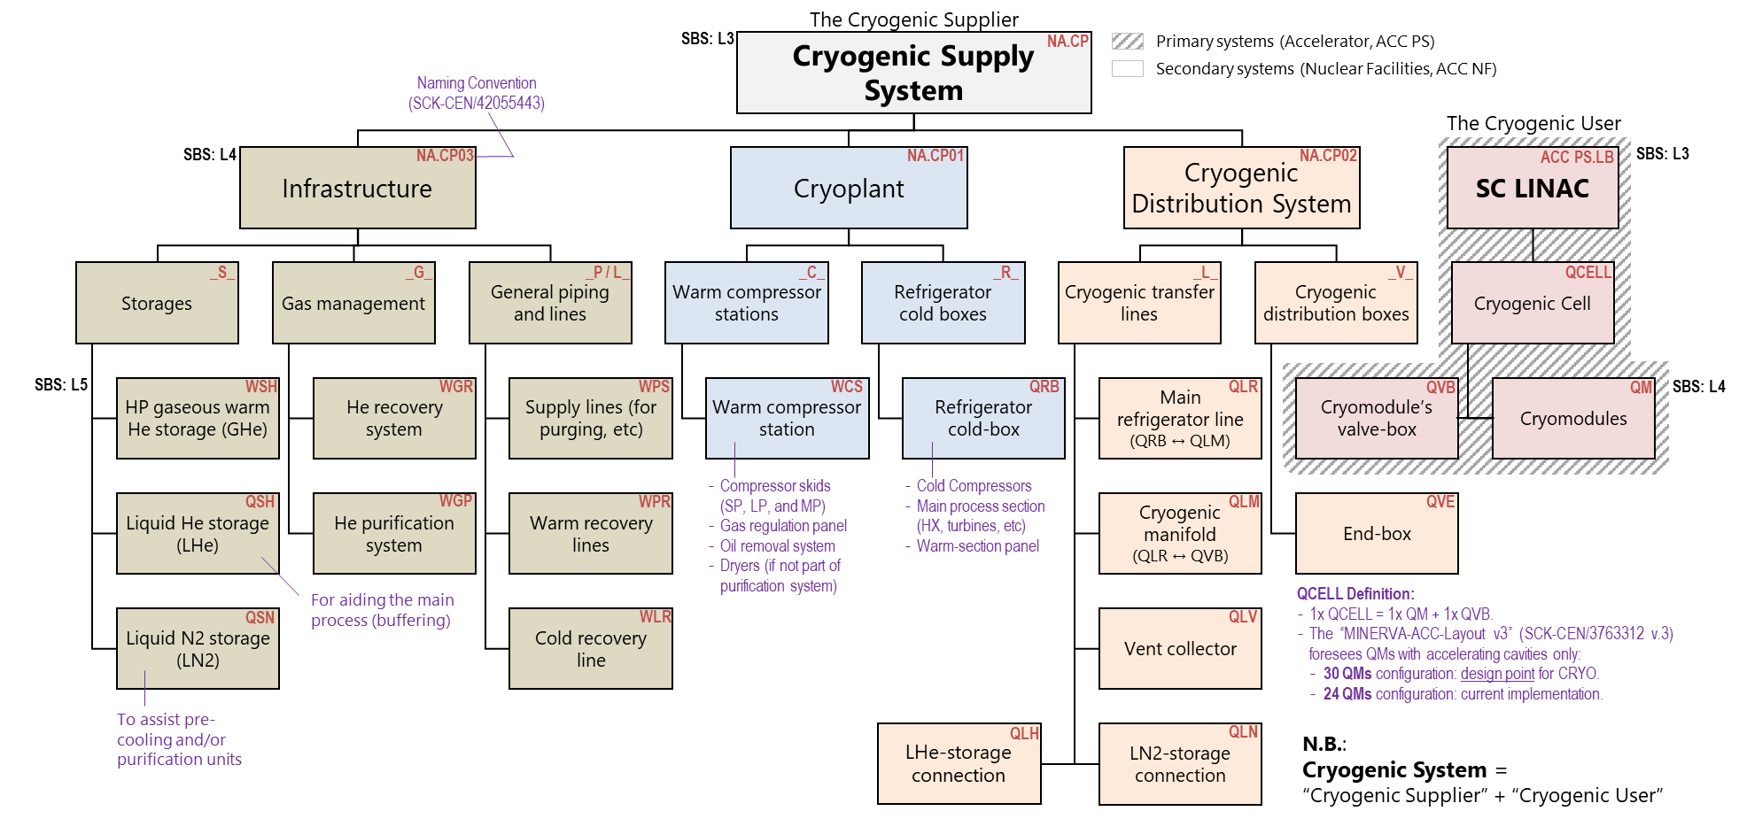
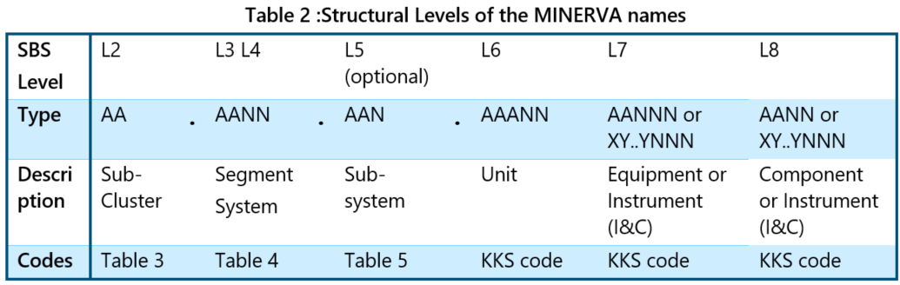
Naming convention – NF side (SBS level 3, sub-system level)
Sub-system naming convention (L5)
A B C ##
Suffix (01-99)
Sub-system type (A-Z)
Sub-system family (A-Z)
Segment system (L3) SBS: “MYRRHA.ACC NA.CP”
NA.CP
Temperature level (Q, W)
Segment system (L4)
NA.CP03
NA.CP01
NA.CP02
Sub-system family
_S_
_G_
_P_
_C_
_B_
_L_
_V_
QCELL
Sub-systems (L5)
WSH
WGR
WPS
WCS
QRB
QLR
QVB
QM
Naming convention for L5: “ABC##”
QSH
WGP
WPR
QLM
QVE
A, 1st Letter: “sub-system temperature”
Q: cold/cryo temperature
W: warm/room temperature
B, 2nd letter: “sub-system family”
C: compressor station
B: cold box
G: general gas management
L: transfer line (with vacuum insulation)
P: pipelines (without vacuum insulation)
S: storage
V: valve box
M: module (reserved for ACC)
QSN
WLR
QLV
QLH
QLN
C, 3rd letter: “sub-system type”
Free choice. Normally indicative of the actual sub-system name.
(from ALX-29756272)
##, 2-digit suffix
From 01 to 99, to differentiate between sub-systems of the same type.
AAANN
Primary system (ACC PS)
Secondary system (ACC NF)
(KKS Standard: ALX-38652240)

Slide 10
Elements within the overall Cryogenic System
Naming convention for elements, valves and instrumentation.

Slide 11
Naming of elements, valves and instrumentation
This naming convention is still under definition.
There are currently 3 possible naming convention under discussion:
To use the primary system naming convention
This convention is anyway mandatory for primary-system elements that are “directly” accessible by the control system (*)
However, this convention is focused in defining the accelerator systems/sub-systems rather than the cryoplant.
To use the secondary system naming convention
This naming convention is based on the “KKS Identification System for Power Stations” (online link) and will be used across MINERVA Nuclear Facilities (water plant, electrical plant, etc…).
KKS codes are well defined and consistent, however they are very abstract (e.g. “AA” = valve, “AC” = heat exchanger). See annex slides for more examples.
To use the “de facto” naming convention adopted for similar projects.
This is a well developed and accepted naming convention used across the cryogenic community. The risk of naming collisions or inconsistencies is low.
An example of this convention is available here (for FREIA).
Requirements for the naming strategy (under discussion)
The ACC naming convention shall be followed when a device (i.e. valve) is “directly” accessible by the control system. (*)
The naming/numbering convention should be uniform across the entire cryogenic system.
The QCELL (QM+QVB) should be considered as a single unit. Naming collision between QVB and QM components are not allowed.
(suggestions)
The valve name may denote its primary function: i.e. CV = control valve, SV = safety valve, etc.
The valve numbering may encode some information. Examples of information that could be encoded are:
The system to which it belongs (cold-box, compressor station, QCELL)
The cooling-circuit to which it belongs (2K, 4K, TS)
The type of line (supply line, return line)
…
Option #3 is the preferred solution and will be adopted.
(*) = see previous slide “Other primary-system mnemonics”

Slide 12
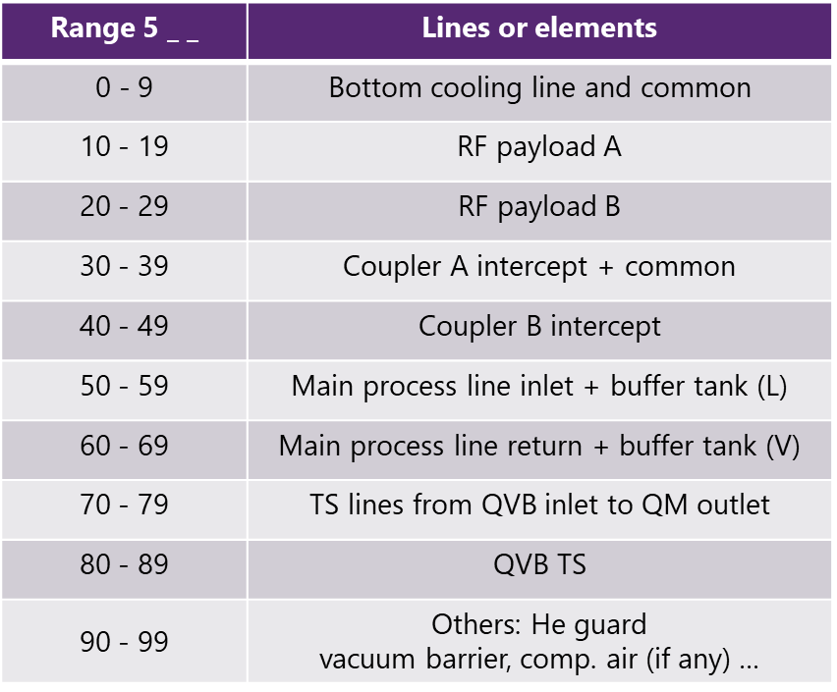
Element instance naming (tag) - Definition
(from ALX-83997343)
Naming convention for instrumentation (tag)
1st digit (XX ABC) = denotes SBS-Item
1 -
2 -
3 -
4 - QVE
5 – QCELL
…
9 – Testing equipment (testQVB, test caps …)
2nd digit (XX ABC) = indicates line or element
Note: tries a “logical split” and exploits symmetry
See table for QCELL (XX 5BC)
XX A B C
Incremental suffix (0-9)
Line or elment (0-9)
SBS-item where is located (1-5)
Component Class (TT, PT, CV, etc)

Slide 13
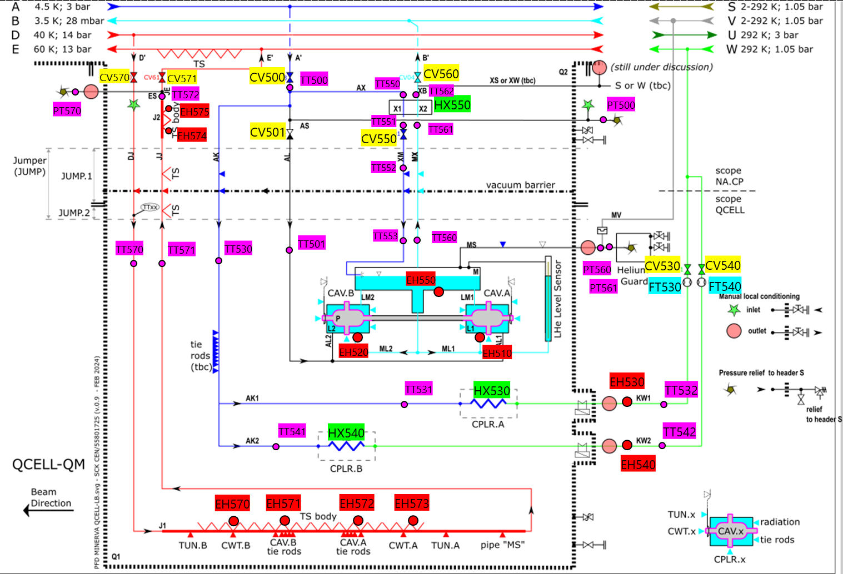
Element instance naming for QCELL
(from ALX-83997343)
tbd
tbd

Slide 14
Element instance naming for QVE

Slide 15
PFD conventions
- Colour coding

Slide 16
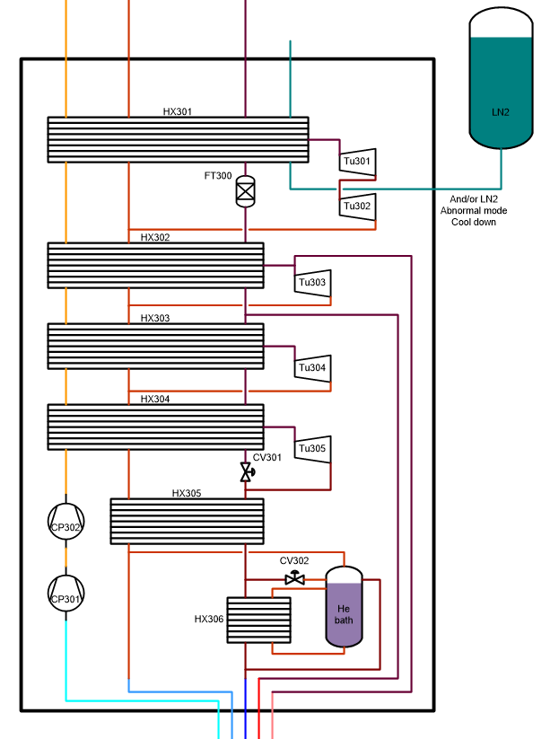
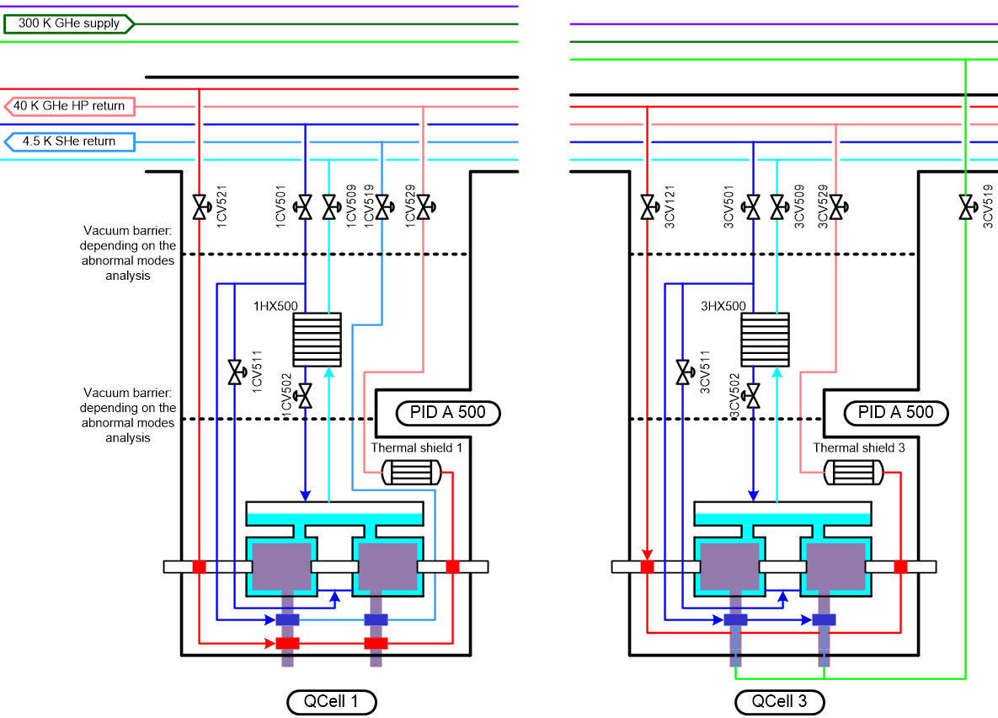
Colour-coding for piping
The following colour-coding is strongly recommended to ease communication and should be used at the authors’ discretion.
Cryodistribution (AN.CP02) and QCELLs
According to the temperature level
2 K level -> Cyan
4K level -> Blue
TS level -> Red
300 K level -> Green
Cold box (QRB) and compressor station (WCS)
According to the pressure level
HP piping -> Orange
MP piping -> Brown
LP piping -> Purple
N.B. The shades of a colour can be used to further differentiate between pipes.
i.e. SHe@5K vs GHe@5K

Slide 17
LINAC operational cases (for design activities)
- Terminology

Slide 18
Terminology of LINAC operational cases (for design activities)
From 2nd ACC status meeting
19-May-2021
(ALX/43723105 )
“AA-BBB-CCC-DDD” → “31-FFT-100-ref”
AA = number of cryomodules (24, 31)
BBB = fault tolerance scheme (FFT, SFT)
CCC = beam end energy in MeV (070, 100, 125)
DDD is the chosen setting (“ref”, “fcs”, “mf#”)
This terminology is to align on the operation cases to aid the design activities. (Not for operating the LINAC)
Definitions (modes & settings)
Chosen settings
Nominal mode | The instance allows for a set-point within a range that respects the margin required for the specific fault-tolerance scheme.
Compensation mode | The instance is utilizing (part of) its operational margin (often up to +30%) to compensate for other elements that have faulted.
Reference settings | An instance operating in nominal mode, with a pre-specified set-point. The operational margin is defined w.r.t. this reference.
Full compensation settings | An instance operating in compensation mode, with its set-point such that it utilizes its entire operational margin.
Chosen setting | Each instance operating with… | Faulted/off instances…
ref (reference settings) | reference settings | n/a
fcs (full compensation settings) | full compensation settings | n/a
mf# (max fault) | full compensation settings (if not faulted or “off”) | Different from case to case
mf1 (max fault case 1) |  | CAVs: 3, 8, 12,… (every 5th)
mf2 (max fault case 2) |  | t.b.d.

Slide 19
Work in progress…

Slide 20
Cryogenic headers and lines
Work in progress…

Slide 21
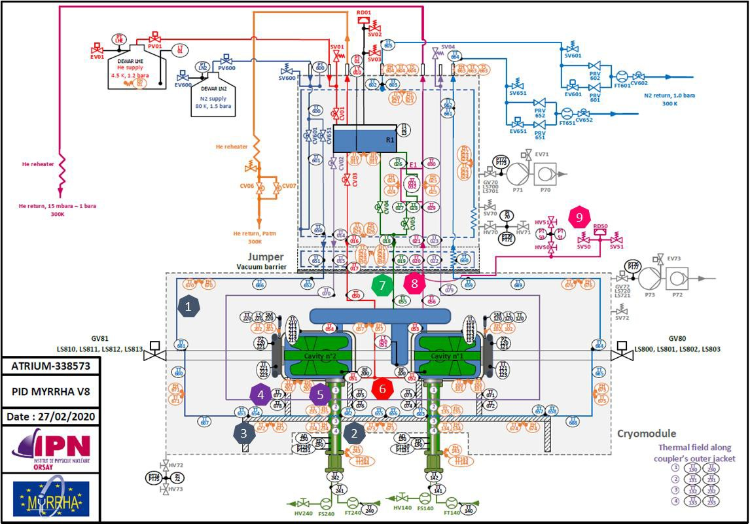
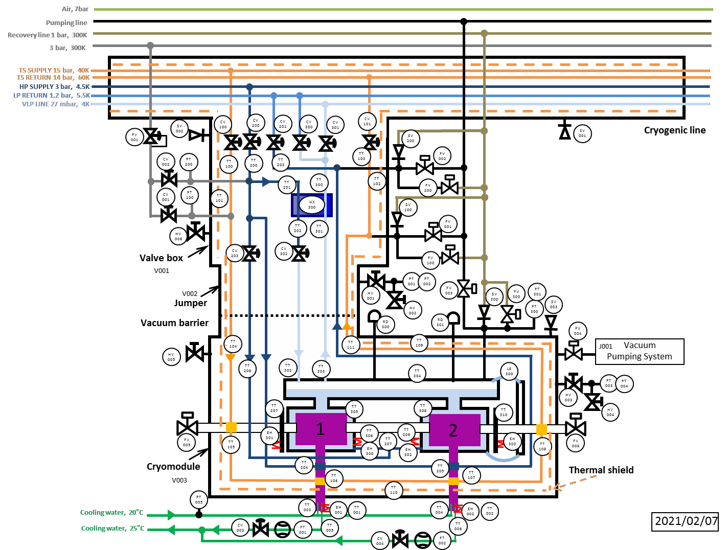
Prototype setup vs Linac setup
Prototype setup
Tunnel setup
Utilizes LHe and LN2 Dewars
Test Valve box (QVB-TLB)
Cryomodule (QM-LB)
Utilizes the cryogenic manifold (QLM) and infrastructure lines (WLR, WPR, WPS)
Valve box (QVB-LB)
Cryomodule (QM-LB)

Slide 22
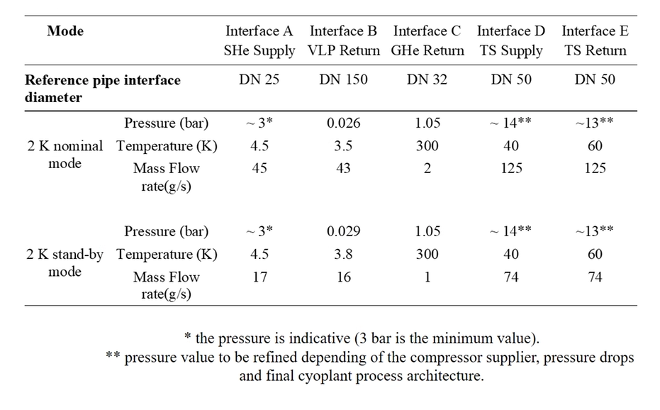
Headers, interconnection pipes, and vacuum vessels of the QCELL
Work in progress…
V
the names for the interconnection pipes are obtained by concatenating the identifiers of the main lines/enclosures.
W
U
DSBT - 6 APR 2023
SCK CEN/54791951
System | Line | Nominal operation |  | Design Pressure (tbc!) | Description
 |  | Pressure | Temperature
 |  | [bar] | [K] | [bar]
Cryogenic backbone (QLM headers within the QVB)
QVB (QLM headers) | A | 3 | 4.5 | 20 | SHe supply header [DN 25]
 | B | i) 0.028 ii) 0.027 | 3.5 | 4 | VLP return header [DN 150] i) header within QVB’s. ii) at QVB//QLM interface
 | D | 13 | 60 | 22 | TS supply header [DN 40]
 | E | 14 | 40 | 22 | TS return header [DN 40]
Service lines (WPR, WPS, WLR)
WLR or WPR | S | 1.05 | 2 to 292 | 22 | Pressure relief line
QLV | V | 1.05 | 2 to 292 |  | Venting line
WLR or WPR | W | 1.05 | 292 |  | Warm/Cold recovery line (tbc if vacuum insulated)
WPS | U | 3 | 292 |  | Warm supply line
Pipes and enclosures - part of cooling circuits
QM | L | 0.31 (x=0) | 2 |  | Cold mass helium enclosure (2x)
QM | M | 0.31 (x=0-1) | 2 |  | LHe phase separator (buffer tank)
QCELL | MB | 0.31 (x=1) | 2 |  | 2K return pipe
QCELL | AL | 1.3 (x=0-1) | 4.5 |  | Filling line (Cool-down / warm-up pipe (and quench?)
QMST | J |  |  |  | Thermal shield circuit (TS body) of QM
CPLR | K | 3 | 4-292 |  | HX circuit on CPLR (2x)
QVB | X |  |  |  | HX circuits on sub-cooling heat exchanger (2x)
Pipes and enclosures - not part of any cooling circuit
QM | P |  |  | 2 | Beam pipe
QCELL | Q |  |  | 1.5 | QCELL Vacuum vessel
D’
E’
A’
B’
S, U, V, W,
Connections
From WPS
To WPR & WLR
X
Q2
Q1
Connection to local pumping lines?
M
L1
L2
P
Free letters:
F, G, N, R, T,
Z = goes to “blind flange”. It needs a cap

Slide 23
Process Pipping Topology
We distinguish between headers and branches.
Branches are categorized into three types:
Main branches (primary):
Participate directly in the cryogenic cooling process by absorbing heat during 2 K operation.
Secondary branches:
Branches with a substantial helium mass flow in at least one operational scenario (e.g. safety discharge, filling).
Tertiary branches:
Remaining branches with negligible to no helium mass flow.
Header
Branch, in 3 flavours
Main (primary)
Secondary
Tertiary

Slide 24
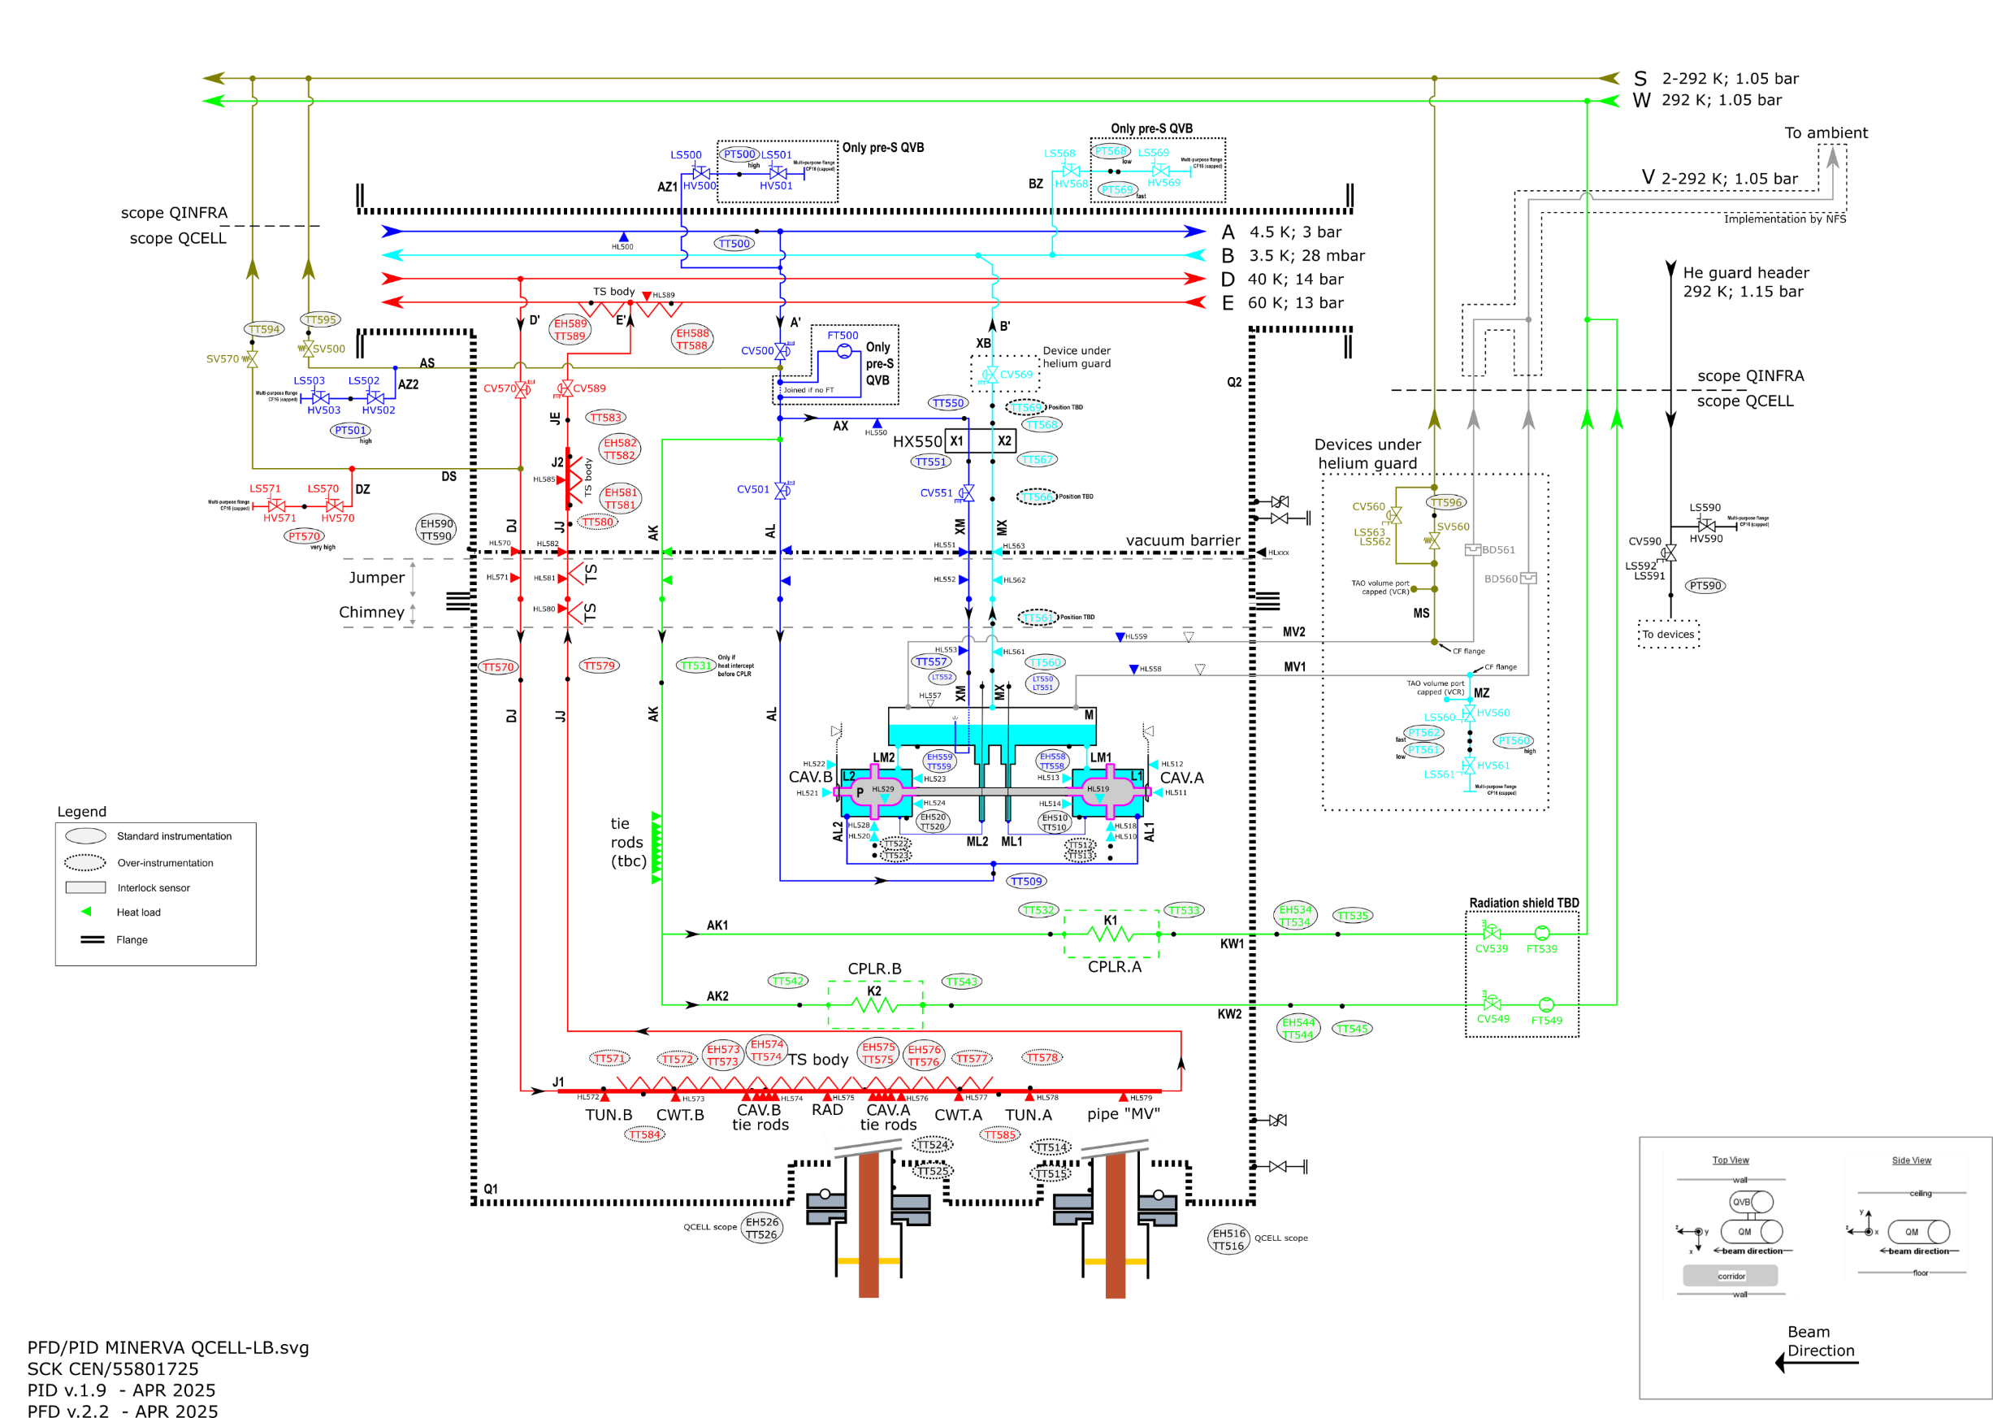
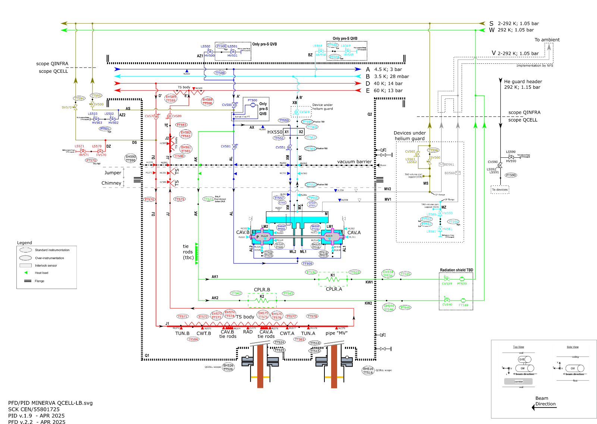
QCELL’s Flow Diagram (example)
Process Circuits
Main branches
CAV@2K (A’-X-M-B’)
TS@50-60K (D’-E’)
CPLR@4K-300K (A’-K-W)
Secondary branches
Filling (A’-L-M-B’)
Pressure relief (AS; ES; MS)
Burst disk (M-MS-S)
Tertiary branches
For pressure sensors
Ports for local conditioning
Ports for RLC-modules against TAOs

Slide 25
PFDs Elements within the Cryogenic System
Naming convention for elements, valves and instrumentation.
Work in progress…

Slide 26
Copyright © SCK CEN - 2021
All property rights and copyright are reserved.
This presentation contains data, information and formats for dedicated use only and may not be communicated, copied, reproduced, distributed or cited without the explicit written permission of SCK CEN.
If this explicit written permission has been obtained, please reference the author, followed by ‘by courtesy of SCK CEN’.
Any infringement to this rule is illegal and entitles to claim damages from the infringer, without prejudice to any other right in case of granting a patent or registration in the field of intellectual property.
SCK CEN
Belgian Nuclear Research Centre
Studiecentrum voor Kernenergie
Centre d'Etude de l'Energie Nucléaire
Foundation of Public Utility
Stichting van Openbaar Nut
Fondation d'Utilité Publique
Registered Office:
Avenue Herrmann-Debrouxlaan 40 - 1160 BRUSSELS - Belgium
Research Centres:
Boeretang 200 - 2400 MOL - Belgium
Chemin du Cyclotron 6 - 1348 Ottignies-Louvain-la-Neuve - Belgium

Slide 27
ANNEX

Slide 28
Examples of Equipment Codes according to the “KKS” standard
(KKS Standard: ALX-38652240)

